Slide 1
Module 5.3 – Dead Reckoning
Sensor Fusion and Kalman Filters

Slide 2
Sensor Fusion
Each type of sensor offers different information about the environment
Combining data from multiple sensors improves the ability of a robot to understand the world
Sometimes sensors disagree, so engineers must design ways to reconcile different inputs.
Notes:
As a motivation for sensor fusion, recall the discussion of the compass and gyroscope for dead-reckoning. Both of these sensors would need to be combined with another sensor to determine linear velocity
Oftentimes the combination of multiple sensors is superior to any single sensor even though some sensors may have high uncertainty
Detecting faults in sensors is made easier when multiple sensors are used because errant measurements will be more obvious.

Slide 3

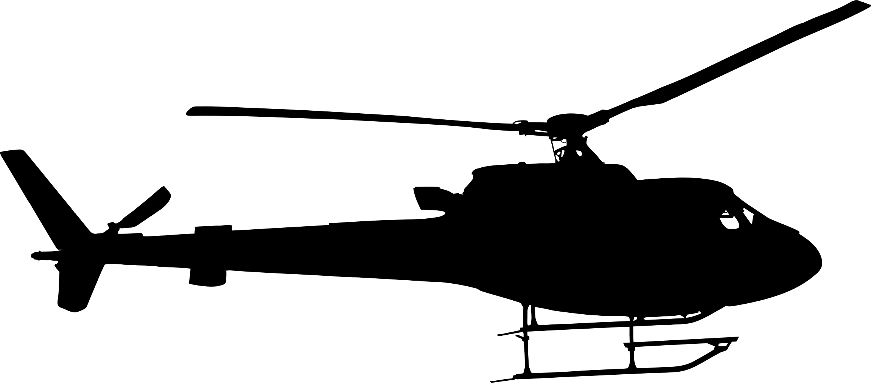
Example: Collision Avoidance
Autonomous helicopters and quadcopters often use a combination of cameras, radar, and lidar for obstacle avoidance
At night or in foggy conditions, lidar and radar may be more effective
During the daytime, cameras may provide more accurate information
Notes:
Collision avoidance is essential to the operation of most autonomous mobile robots, so the more information that robots can gather about their surroundings the more likely they will be to avoid collisions
It is important when designing a robot to include sensors that are complimentary - some sensors are useful during certain situations while other sensors are a useful during other conditions
Rarely will there be a single type of sensor input that is always reliable; however, the cost, size, and power requirements of sensors must be considered before adding every sensor to a robot
In the autonomous helicopter example, the lidar/radar and cameras can be used in different conditions (foggy vs. clear) or simultaneously to improve accuracy

Slide 4
Explicit Sensor Fusion
One solution to sensor fusion is writing rules based on multiple sensors
Example: Obstacle Avoidance
if (sonarValue < 10 && cameraDetectsObject) { avoidObstacle(); }
Example: Localization
x_pos = ((x_pos + vel_x * time_diff) + gps_x) / 2 y_pos = ((y_pos + vel_y * time_diff) + gps_y) / 2
Notes:
The first attempt at combining sensor values would be writing code that specifically handles different scenarios
This concept was used in the Sense and Avoid lab to turn the robot after it had retreated more than a threshold and the object was no longer present.
The second example on the page takes a simple average of the position estimated by a dead-reckoning system and the gps estimate.
Explicit rules for combining sensors can be useful for simple sensor data or specific cases where the expected behavior is known.
However, code will become unmaintainable and complex if too many rules and conditionals are used to fuse sensor data.

Slide 5


Probabilistic Sensor Fusion
A more generic approach to sensor fusion uses probability
Each sensor has an estimate and an uncertainty (variance)
The combined estimate and variance is given by equations below
Sensors a and b are inputs and c is the combined sensor reading
is the estimate of the sensor x
is the variance of the sensor x
Notes:
This update assumes that the real state value follows a Gaussian distribution with the center at Ux and the variance as Vx.
High variance implies the sensor is uncertain about its measurement while low variance implies more certainty
The first equation computes the estimated combination of the sensors by weighting the sensor with less uncertainty higher because we trust the sensor with less uncertainty more.
The variance (uncertainty) of the fused sensor reading will always be less than either of the two sensor’s uncertainties.
Consider the case where the variance of sensor a approaches 0 (complete certainty). When this happens, the fused sensor data will be nearly equivalent to sensor a and the combined uncertainty will approach 0 as well

Slide 6
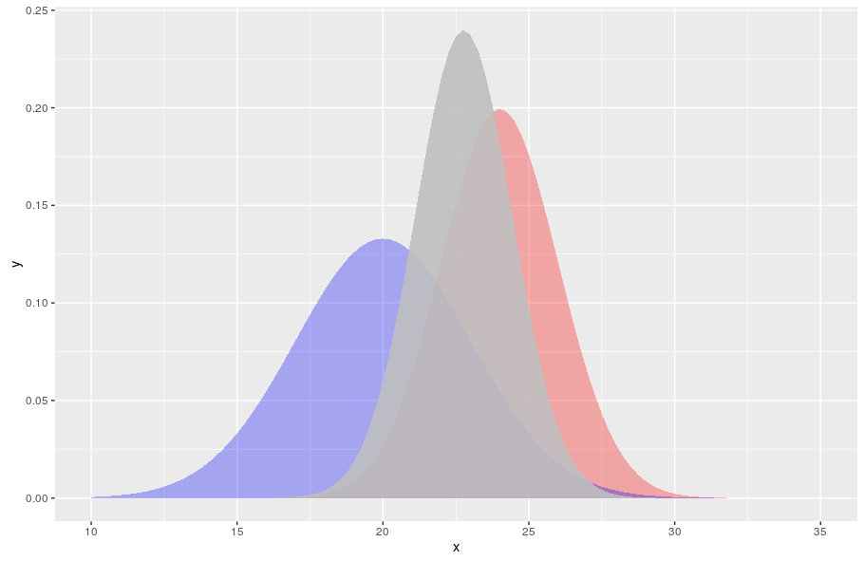
Probabilistic Sensor Fusion: Example
Sensor A (red)
u = 23
v = 4
Sensor B (blue)
u = 20
v = 9
Combined Sensor (gray)
u = 22.77
v = 2.77
Notes:
Here is an example with real numbers that demonstrates how sensors can be fused using probability
Notice that the gray curve has a higher peak that either of the raw sensor readings because we have greater certainty with the combination.
The value of the combined sensor 22.77 is closer to sensor A’s value than sensor B’s value because sensor A has less uncertainty

Slide 7
Kalman Filters
Kalman filter is an algorithm that can be applied to automate sensor fusion.
Kalman filters produce a probabilistic estimate of a state based on the past state, predicted changes, and sensor updates
The state predicted by a Kalman filter can be anything that the robot needs to know (position, velocity, proximity of obstacles, etc.)
Notes:
Kalman filters are a powerful technique that has been applied to many areas of robotics including tracking and localization
Kalman filters are a method of probabilistically fusing sensor data that is more flexible than the basic weighted sum that was discussed previously
The output of a Kalman filter is a predicted state (e.g. the location of the robot) as well as the uncertainty of that prediction.

Slide 8
Steps of a Kalman Filter
Predict: the first step is to estimate change in the state based on the previous state and inputs
Update: the second step is refine that state estimate with the measured data
Notes:
The predict step occurs independently of the sensor data; it is based solely on the previous state estimation and the expected transition of the state
The update step incorporates the sensor data to change the previously estimated state to more closely align with the sensor data
The result of the Kalman filter will be a weighted combination of the state prediction from the expected state transition and the state estimated by the measurement data

Slide 9

Predicting: Estimate the state
The state (x_{t}) is estimated by applying a state transition matrix (F) to the previous state (x_{t-1})
Another transition matrix (B) is applied to the input vector (u)
Notes:
The state can be a vector or a scalar value; in localization often the state is x,y,z,orientation,x-velocity, and y-velocity.
Usually F has 1’s on the diagonal because we expect most values in the state to stay the same from timestep to timestep; however, in certain environments some state values may decay over time (e.g. due to friction)
Additionally there will be non-zero entries in F where a state value depends on another; for example, the x-position should be updated to be the previous x-position + x-velocity
The input vector is the same length as x and it represents an change to the state. For example, if you send a command to move forward, the u vector may have a nonzero value in the x-velocity indicating an increase in velocity
The transition matrix matrix B has the same shape as F but may have different values

Slide 10

Predicting: Estimate the Covariance
The covariance (P_{t}) is estimated by multiplying the state transition matrix (F) times the previous covariance (P_{t-1}) times the transpose of the transition matrix
A fixed matrix Q is added, which causes the covariance to increase after each iteration.
Conceptually covariance is a measure of the uncertainty of the estimate
Notes:
Along with estimating the state vector, the Kalman filter also estimates the current covariance. P is a square matrix with dimensions equal to the length of the state vector.
The covariance matrix is a generalization of the variance that was discussed in the probabilistic sensor fusion
The multiplication of the state transition matrix by the previous covariance will increase the covariance estimate proportional to the magnitude of the transition matrix.
This is an intuitive result because if the state changes dramatically at each timestep then our uncertainty should increase significantly
The Q matrix serves to continuously add uncertainty to the system

Slide 11

Updating: Refine the State
The measurement estimation matrix (H) is multiplied by the estimated state (x_{t}) to produce an estimate of the measurement.
The difference between the expected measurement and the actual measurement vector (z_{t}) is multiplied by a scalar called the Kalman Gain (K) to refine the state estimate.
Essentially this updates the state based on the measurement data collected.
Notes:
The measurement estimation matrix H scales the state estimate to match the expected sensor data if the state estimate were perfectly accurate
If the measurement data is greater than the scaled state estimate, then the refined state estimate will be increased according to the Kalman gain
If the Kalman gain is zero, then the measurement data does not affect the state.

Slide 12

Updating: Refine the Covariance
Finally the covariance matrix (P_{t}) is updated by subtracting the multiplication if the Kalman Gain (K), the measurement estimation matrix (H) and the original estimated covariance (P_{t}).
Notes:
The update of the covariance increase the uncertainty of the components of the state that were most changed by the measurement data.
If the Kalman gain is zero, then the state was not changed by the measurements so the covariance does not change

Slide 13
Kalman Gain
Kalman Gain is calculated at each iteration of the Kalman filter based on the measurement estimation matrix, the state covariance, and the covariance of the measurement vector.
A high Kalman gain will increase the impact of the measurements because the measurements have high certainty
A low Kalman gain will mostly ignore the measurement data
Notes:
There are a variety of techniques for calculating the Kalman Gain.
The most popular and simplest Kalman Gain equation is called optimal Kalman Gain.
Intuitively, the Kalman gain should be scaled based on the covariance of the measurement data and the state uncertainty.
The Kalman Gain generalizes how we weighted the sensor estimates in the probabilistic sensor fusion section

Slide 14
Limitations of Kalman Filters
Require linear (or nearly linear) relationships
Single state estimate (unimodal)
Notes:
The basic Kalman filter is only useful when the inputs have linear effects on the state. More advanced techniques like Extended Kalman Filter and Unscented Kalman Filter can handle non-linear effects
Kalman filters produce only a single estimate with variance for each component of the state; they cannot represent multiple possible states. When multiple states are possible, particle filters can be useful (which will be discussed in the Localization module)

Slide 15
The GPU Teaching Kit is licensed by NVIDIA and California Polytechnic State University under the Creative Commons Attribution-NonCommercial 4.0 International License.

